Slide 1

Phaser Game Library
Overview:
What files do you need?
How is a game structured?

Slide 2
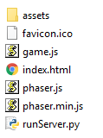
What files do you need?
assets – to hold the images / sounds
favicon.ico – the icon file for the browser
game.js – where you put your game code
index.html – just launches the game code
phaser.js – the game library
phaser.min.js – minimised game library
runServer.py – to start the server

Slide 3
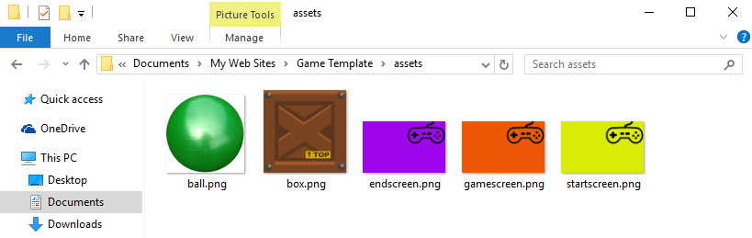

assets folder
all visual assets can be PNG files
when you come to use sounds, include them as duplicate MP3 and OGG files: Phaser will use whichever file format is best for your browser.

Slide 4
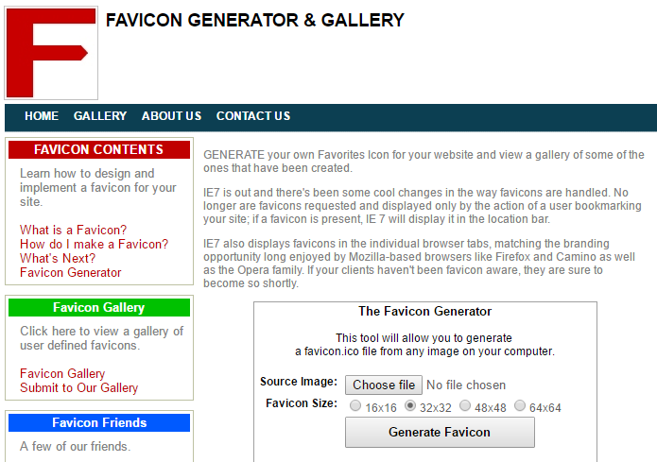
favicon.ico
short for ‘favourite icon’
this is the small image that will show in the browser URL
the easiest way to make your own is to upload a PNG to http://www.favicon.co.uk and let it convert your image for you.

Slide 5
runServer.py
a simple script to create a file server for Python 3
run it and then navigate to localhost:8000 on your browser
if you have a file there called index.html, it will automatically open it

Slide 6
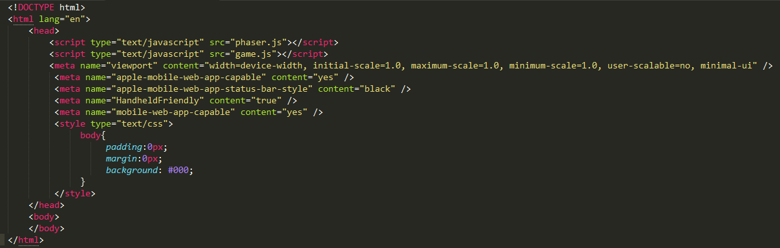
index.html
contains metatags as suggested by mobile manufacturers to best display the game full-screen on their devices (and launches game.)

Slide 7
phaser.js
the game library – full human-readable version (2859 KB) which is used during development in case you need to look at it
when your game is completed, you can replace this with phaser.min.js, which has all unnecessary space removed (587 KB)

Slide 8
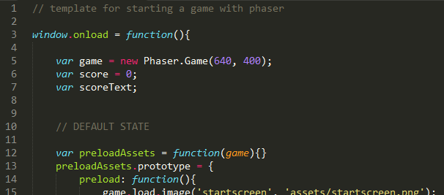
game.js – this is where you write your code

Slide 9
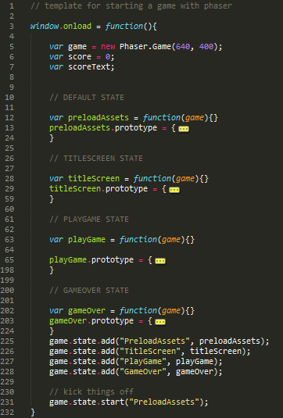
Overview of game template
load game and declare variables
preload assets
run the title screen loop (state)
run the game loop (state)
run the gameover loop (state)
add the states to the game

Slide 10

Phaser.Game – getting started
When the window loads, you create one a game variable and call it game.
This game object contains everything needed to make your game, such as the drawing of windows, creation of sprites, detection of collisions, etc.
This is also where you declare any variables that need to be global. They’re not really global, but they’ll be alive in the same scope as your game variable, so you can access them in all functions.

Slide 11
Simple structure of a game – the big picture
Each box can be thought of as a GAME STATE.
It simplifies game development if each state can be handled separately.
There could be more states, such as levels, if the game is complex.
LOAD ASSETS
START SCREEN
PLAY GAME
GAME OVER

Slide 12
Game States
DEFAULT STATE
Phaser games have at least one state. Each state must contain at least one of these functions:
Preload – load things
Create – make things
Update – change things
Render – you won’t need it
LOAD ASSETS
TITLESCREEN STATE
START SCREEN
PLAYGAME STATE
PLAY GAME
GAMEOVER STATE
GAME OVER

Slide 13
Game States

Slide 14
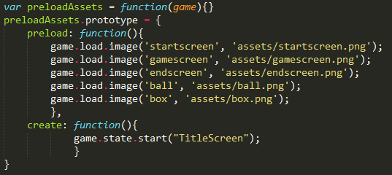
DEFAULT STATE
Jump to next state

Slide 15
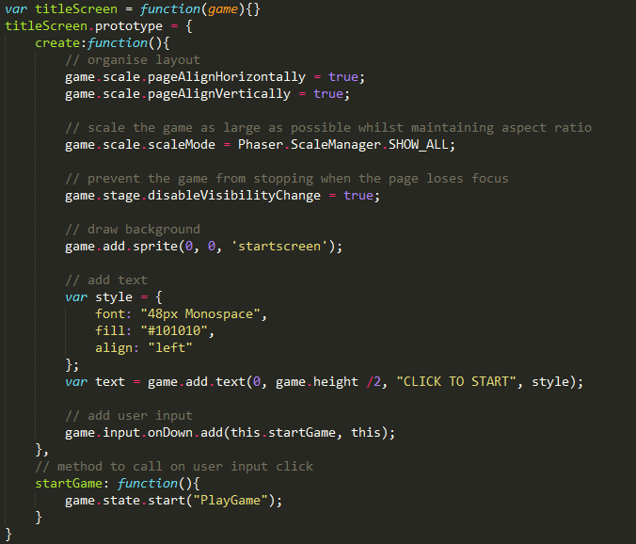
TITLESCREEN STATE
On the TitleScreen, if they click anywhere, it will trigger the next game state, by calling a function.
If clicked…
Jump to next state

Slide 16
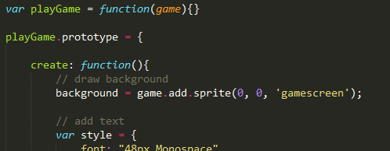
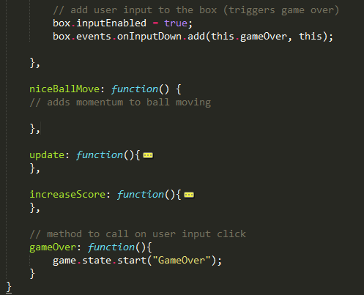
PLAYGAME STATE
In PlayGame, if they click on the box, it will trigger the next game state, by calling a function.
If clicked…
Jump to next state

Slide 17
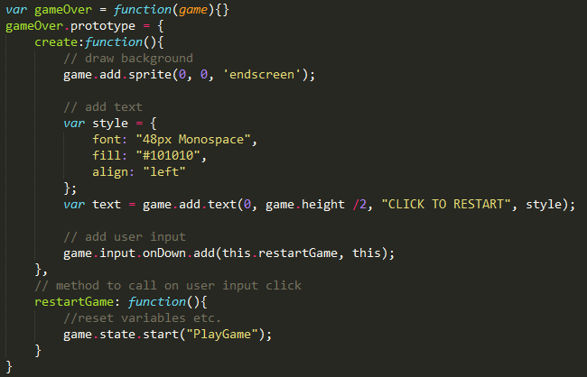
PLAYGAME STATE
In GameOver, if they click anywhere, it will trigger the next game state, by calling a function.
If clicked…
Jump to next state

Slide 18
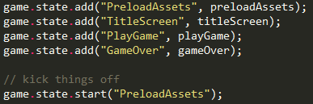
Adding the states
Jump to next state
At the end of the window.onload function (i.e. the very end of all the code) the states are added and the PreloadAssets state is started.

